Slide 1

Optimizing the Level of Commitment in Demand Response
Joshua Comden, Zhenhua Liu, Yue Zhao
ACM GREENMETRICS 2016
Notes:
Thanks Prof. Carlsson.

Slide 2
Solar + Wind energy outpaces DR adoption
California State Legislature solution (2013):
1,325 MW of grid storage by 2020
Expensive
Not environmentally friendly
http://energyalmanac.ca.gov/electricity/electric_generation_capacity.html
FERC Assessment of Demand Response and Advanced Metering Staff Reports: 2010-2015.
CAISO Demand Response Barriers Study 2009.

Slide 3
Goal: Increase reliable DR adoption
Approach: Flexible Commitment DR Program
Modeling
Simulation
Notes:
FCDR will optimize the Level of Commitment.

Slide 4
Why optimize the Level of Commitment?
Because DR Programs have various Levels of Commitment
Customer Load Reductions
Mandatory
Voluntary
Base Interruptible Program (BIP)
Emergency Response Service (ERS)
Special Case Resources (SCR)
CAISO
ERCOT
NYISO
Demand Bidding Program (DBP)
Voluntary Load Reduction (VLR)
Emergency DR Program (EDRP)

Slide 5
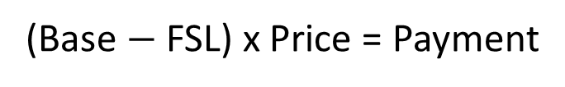
Example: BIP requires load reductions
30 min
up to 6 hr
Base
Load
(Base $−$ FSL) x Price = Payment
FSL
High Penalties for each kWh above FSL
time
1
2
3
LSE signals customer to reduce load.
Customer must reduce load to Firm Service Level (FSL).
LSE releases the signal.
Southern California Edison 2010 fact sheet.

Slide 6
Example: DBP does not require load reductions
> 1 day
> 2hr
Load
Base
(Energy from Base) x Price = Payment
Bid
No Penalties for not reducing
(even for bids)
time
1
2
3
LSE sends signal for event.
Start of event:
End of event.
Customer bids with demand reduction.
Customer can reduce load to 50-200% of bid amount.
Southern California Edison 2010 fact sheet.

Slide 7
Mandatory programs impose risk onto customers
Baseline
Difficult to meet the
Firm Service Level
vs.
Voluntary Programs are not dispatchable for LSE.
UMass Trace Repository: Smart* Data Set

Slide 8
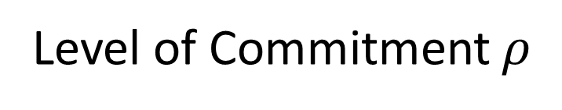
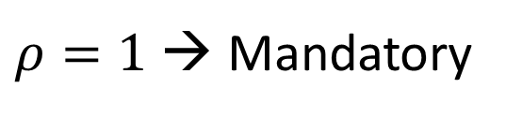
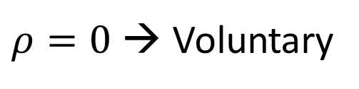
The Level of Commitment can be adjusted
LSE signals the Customer
to reduce load
Customer reduces load with
probability $≥ρ$
Customer reduces load with
probability ≥𝜌
Level of Commitment $ρ$
$ρ=0$ → Voluntary
$ρ=1$ → Mandatory
Flexible Commitment Demand Response (FCDR)

Slide 9
Most customer loads are only weakly correlated
Correlation Matrix of 395 Buildings in Massachusetts
ISO-NE
Average correlation = 0.03
Can be treated as independent.
LSE’s need for DR can be
treated as independent.
UMass Trace Repository: Smart* Data Set
Notes:
Explain the heatmap scale. Most are only weakly correlated.

Slide 10
Goal: Increase reliable DR adoption
Approach: Flexible Commitment DR Program
Modeling
Simulation

Slide 11
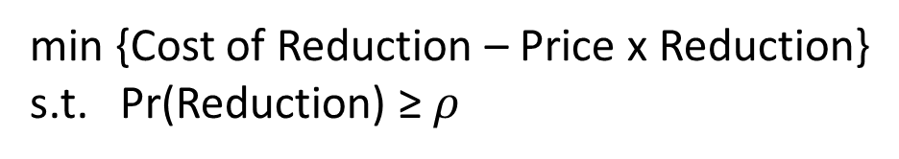

After Level of Commitment, Price determines reduction
Reduce Load (kW)
Customers
LSE
min {Cost of Mismatch + Price x Reduction}
min {Cost of Reduction – Price x Reduction}
s.t. Pr(Reduction) ≥ $ρ$
Level of Commitment $ρ$
Price ($)
Notes:
Mention that the LSE predicts the customers behavior (Not iterative method of optimization)
Mention that the LSE decides LOC and p (who makes the decision is for future work)

Slide 12
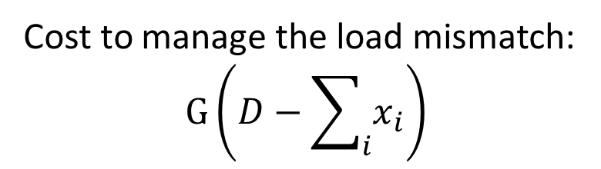
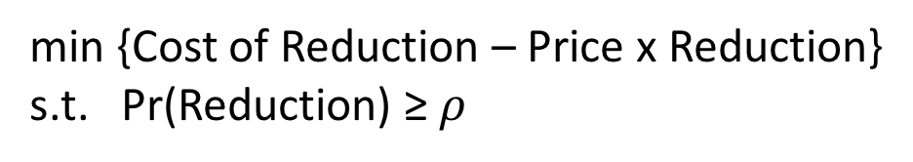
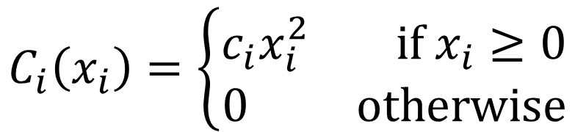
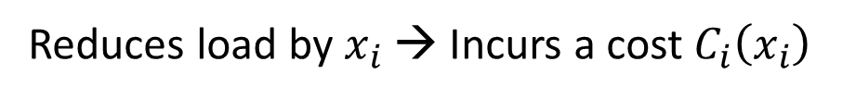
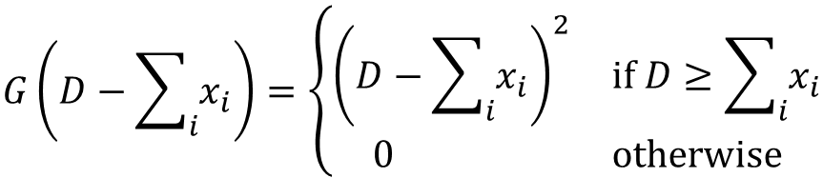
After Level of Commitment, Price determines reduction
Customers
LSE
min {Cost of Reduction – Price x Reduction}
s.t. Pr(Reduction) ≥ $ρ$
min {Cost of Mismatch + Price x Reduction}
Cost to manage the load mismatch:
$$G\left(D−\sum_{i}{x_{i}}\right)$$
Reduces load by $x_{i}$ → Incurs a cost $C_{i}\left(x_{i}\right)$
Increasing marginal cost
Increasing marginal cost
Ex:
Ex:
$$C_{i}\left(x_{i}\right)=\left\{\begin{aligned}c_{i}x_{i}^{2} if x_{i}≥0 \\ 0 otherwise\end{aligned}\right.$$
$$G\left(D−\sum_{i}{x_{i}}\right)=\left\{\begin{aligned}{\left(D−\sum_{i}{x_{i}}\right)}^{2} if D≥\sum_{i}{x_{i}} \\ 0 otherwise\end{aligned}\right.$$
Notes:
Mention that our model is general enough for other cost functions.

Slide 13
Goal: Increase reliable DR adoption
Approach: Flexible Commitment DR Program
Modeling
Simulation

Slide 14
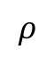
How much can FCDR save?
1
h
Large Reductions just below 1
Low levels: the customers volunteer a higher Level of Commitment.
The optimal exists between 0 and 1, and it’s even better than 0.
A
Normalized Social Cost
0.9
B
C
0.8
0.7
0.6
Up to 50% reduction
in Social Cost
0.5
0.4
0
0.2
0.4
0.6
0.8
1
$$ρ$$
Cost (Society) = Cost (LSE) + Cost (Customers)

Slide 15
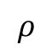
FCDR extracts more DR
Expected Aggregated DR (kWh)
35
A
30
B
25
C
20
Up to 40% more
15
10
5
0
0
0.2
0.4
0.6
0.8
1
$$ρ$$

Slide 16
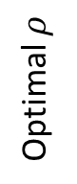
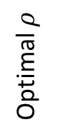
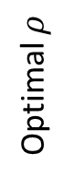
LSE’s optimal mimics the Society’s optimal.
Home B
1
Home A
0.8
1
0.6
0.8
Optimal $ρ$
Home C
1
0.4
0.6
Optimal $ρ$
0.8
0.2
0.4
LSE
Society
0.6
LSE
0.2
Optimal $ρ$
20
30
40
50
60
70
80
Society
0.4
Desired DR (kWh)
20
30
40
50
60
70
80
LSE
Desired DR (kWh)
0.2
Society
20
30
40
50
60
70
80
Desired DR (kWh)

Slide 17
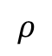
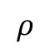
What are the LSE’s and customer’s optimal levels?
Customer
LSE
0
x10⁻⁴
1
A
A
-0.2
0.9
B
B
C
-0.4
C
0.8
-0.6
Normalized LSE Cost
Normalized Customer Cost
-0.8
0.7
-1
0.6
-1.2
0.5
-1.4
0
0.2
0.4
0.6
0.8
1
0
0.2
0.4
0.6
0.8
1
$$ρ$$
$$ρ$$
LSE’s cost is very similar to the Society’s cost.

Slide 18
Goal: Increase reliable DR adoption
Approach: Flexible Commitment DR Program
Modeling
Simulation

Slide 19
Goal: Increase reliable DR adoption
Approach: Flexible Commitment DR Program
Cost reduction up to 50%
DR extraction increased up to 40%
Notes:
Mention that LSE mimics the Social Opt.
Mention that this is just the initial step into the problem space, and there is plenty of room for future exploration.
We welcome any collaborations!

Slide 20
Optimizing the Level of Commitment in Demand Response
Joshua Comden, Zhenhua Liu, Yue Zhao
Thank you!
ACM GREENMETRICS 2016

Slide 21
Customer’s cost of reduction at peak loads is high
Peak reduction is rare but costly.
Cost of reduction has an
increasing marginal cost:
e.g. Turning AC off is much more
Inconvenient than turning it to low
UMass Trace Repository: Smart* Data Set

Slide 22
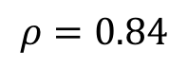
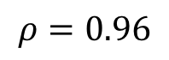
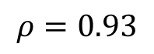
How does the Level of Commitment extract DR?
Customer DR Supply Curves
25
20
15
Expected Aggregate DR (kWh)
10
$$ρ=0.84$$
5
$$ρ=0.93$$
$$ρ=0.96$$
0
0
0.05
0.1
0.15
0.2
price ($/kWh)
Notes:
LOC increases size of jump and price of jump
LOC can increase DR with same price

Slide 23
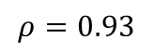
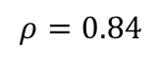
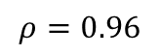
How does the Customer make its decision?
Commitment Threshold
Firm Service Level
0.3
x10⁻⁵
0
0.25
-2
0.2
-4
y^{u} (kWh)
Customer Cost ($)
-6
0.15
$$ρ=0.84$$
-8
p = $0.037/kWh
0.1
$$ρ=0.93$$
p = $0.040/kWh
$$ρ=0.96$$
-10
p = $0.043/kWh
0.05
0.05
0.1
0.15
0.2
0.02
0.04
0.06
0.08
0.1
price ($/kWh)
y^{l} (kWh)
Customer minimally commits to DR
at low prices
DR Supply jump created by
multiple local minima

Slide 24
LSE’s cost of load mismatch is high with low DR.
Cost of managing the mismatch between supply
and demand has an increasing marginal cost:
e.g. only the most expensive energy sources
are available as demand increases
ISO-NE

Slide 25
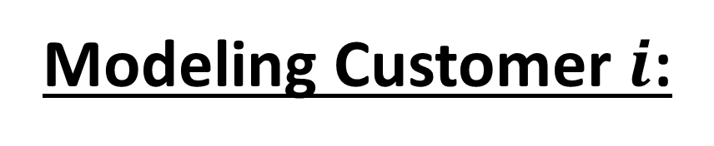
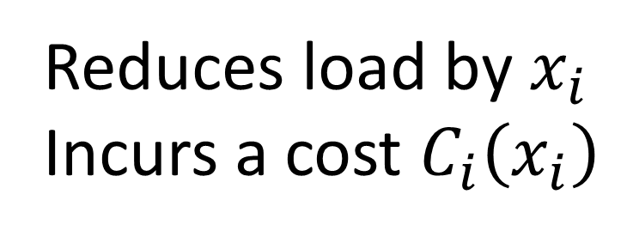
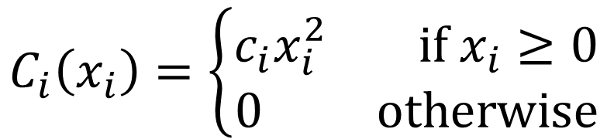
Modeling Customer $i$:
Reduces load by $x_{i}$
Incurs a cost $C_{i}\left(x_{i}\right)$
Increasing marginal cost
E.g. one-sided quadratic:
$$C_{i}\left(x_{i}\right)=\left\{\begin{aligned}c_{i}x_{i}^{2} if x_{i}≥0 \\ 0 otherwise\end{aligned}\right.$$
Notes:
Turning AC off is much more uncomfortable than only turning it down.
Explain intuition of Quadratic: Small reductions are easy. Large reductions are much harder.

Slide 26
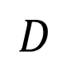
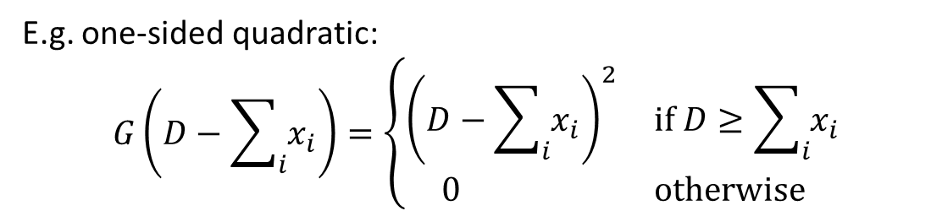
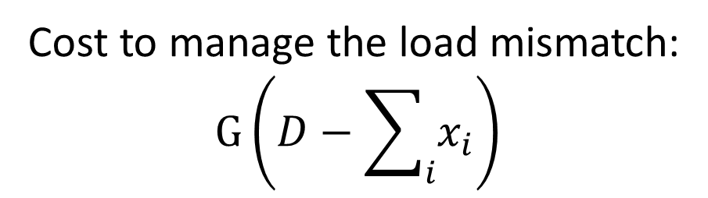
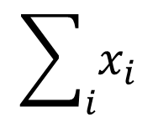
Modeling the LSE:
DR
$$\sum_{i}{x_{i}}$$
Cost to manage the load mismatch:
$$G\left(D−\sum_{i}{x_{i}}\right)$$
Load
Demand
$$D$$
Provisioned Supply
Increasing marginal cost,
E.g. one-sided quadratic:
$$G\left(D−\sum_{i}{x_{i}}\right)=\left\{\begin{aligned}{\left(D−\sum_{i}{x_{i}}\right)}^{2} if D≥\sum_{i}{x_{i}} \\ 0 otherwise\end{aligned}\right.$$
time
Notes:
Explain intuition of Quadratic: Larger mismatches require more expensive energy sources.

